Slide 1




B.TECH MINOR PROJECT PRESENTATION 2020-21
TOPIC: To Minimize the Energy Consumption for Communication Protocol using IOT.
Project ID:21116
National Institute of Science & Technology
By
Name:Suman Priya Sahu
Roll NO:201711357
BPUT Reg NO:1701202262
Name:Manisha Panda
Roll NO:201741413
BPUT Reg NO:1701202078
Under the guidance of:
Mr.Rabindra Kumar Shial
Suman Priya Sahu- CSE/201711357 & Manisha Panda- CSE/ 201741413
[1]

Slide 2
B.TECH MINOR PROJECT PRESENTATION 2020-21
CONTENT
LEACH Protocol
Phases Of LEACH Protocol
Algorithm of Set-Up Phase
Algorithm of Steady-State Phase
Stimulation Result
Comparison LEACH v/s I-LEACH
Future Work
Conclusion
National Institute of Science & Technology
Suman Priya Sahu- CSE/201711357 & Manisha Panda- CSE/ 201741413
[2]

Slide 3
B.TECH MINOR PROJECT PRESENTATION 2020-21
LEACH PROTOCOL
LEACH Protocol:
It is used in wireless sensor network to reduce the energy consumption among different node and cluster form in the network.
A LEACH Protocol is mainly used for:
Aggregation of the data by cluster head.
For shortening of the transmission distance.
Used in Network requiring configuring of the nodes.
To improve the lifetime of the WSN.
Probability selection of clusters.
National Institute of Science & Technology
Suman Priya Sahu –CSE/201711357 & Manisha Panda- CSE/ 201741413
[3]

Slide 4
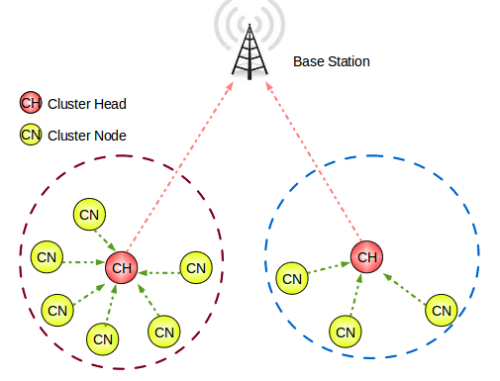
B.TECH MINOR PROJECT PRESENTATION 2020-21
PHASES OF LEACH PROTOCOL
LEACH Protocol has two phases:
The Set-up Phase
The Steady-State Phase
The Set-Up Phase where the cluster head are chosen.
The Steady-State Phase where the cluster head is maintained where the data is transmitted between the nodes.
National Institute of Science & Technology
Suman Priya Sahu –CSE/201711357 & Manisha Panda- CSE/ 201741413
[4]

Slide 5
B.TECH MINOR PROJECT PRESENTATION 2020-21
ALGORITHM OF SET-UP PHASE
In this stage, clusters are made and CHs are chosen:
For Each (N)
N selects a random number T (n) between 0 and 1 If (T (n) < threshold value)
N becomes a Cluster-Head
N transmits a message announcing its CH status Else
N becomes a typical node
N receives the announcing message of CHs End if
End for
For Each (CH)
Calculate a distance from N to CH and from CH to BS
N chooses the CH with minimum distance from it to CH to BS
N apprises the selected Cluster-Head and becomes a cluster part
End for
For Each (CH)
TDMA schedule is made by Cluster-Head for each node to transfer data
TDMA schedule is advertised to each node in the cluster by Cluster-Head
End for
National Institute of Science & Technology
Notation:
N: number of nodes
CH: cluster head
BS: a base station
Suman Priya Sahu –CSE/201711357 & Manisha Panda- CSE/ 201741413
[5]

Slide 6
B.TECH MINOR PROJECT PRESENTATION 2020-21
ALGORITHM OF STEADY-STATE PHASE
In this stage, data is aggregated and transmitted from cluster head to base selection:
For Each (N)
N gathers data that has been sensed
N transfers the data that has been sensed into the Cluster-Head in the corresponding TDMA time point.
End for
For Each (Cluster-Head)
Cluster-Head gets data from the cluster nodes Cluster-Head aggregates the data
Cluster-Head transfers the data to the base station
End for
National Institute of Science & Technology
Notation :
N: number of nodes.
CH: cluster head
Suman Priya Sahu –CSE/201711357 & Manisha Panda- CSE/ 201741413
[6]

Slide 7
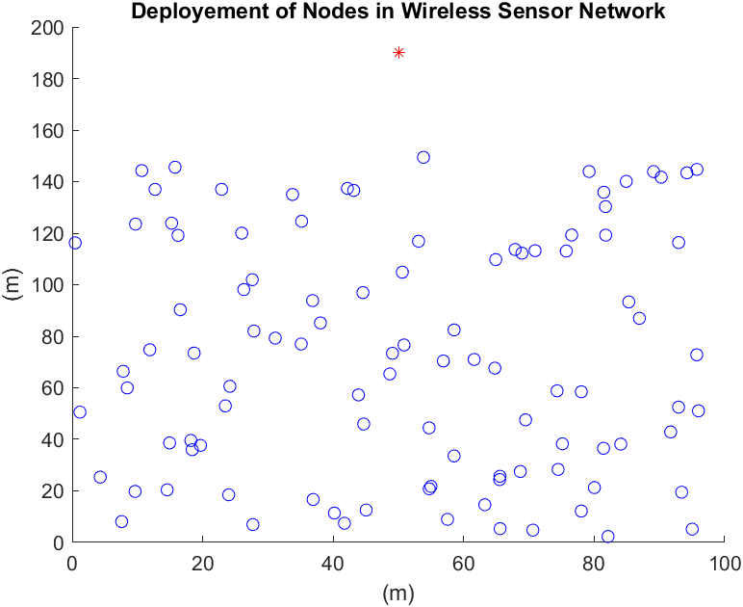
B.TECH MINOR PROJECT PRESENTATION 2020-21
SIMULATION RESULT
National Institute of Science & Technology
Suman Priya Sahu –CSE/201711357 & Manisha Panda- CSE/ 201741413
[7]

Slide 8
B.TECH MINOR PROJECT PRESENTATION 2020-21
COMPARISION BETWEEN LEACH V/S I-LEACH
In low energy adaptive clustering hierarchy (LEACH) protocol and present ideas for improvement by selecting the cluster head node. The main problem with LEACH lies in the random selection of cluster heads. There exists a probability that the formed cluster heads are unbalanced and may remain in one part of the network, which makes some part of the network unreachable. In this project, we will present a new version of the LEACH protocol called the Improved LEACH (ILEACH) protocol, which a cluster head is selected based on its ratio between the current energy level and an initial energy level, and multiplies by the root square of its number of neighbour nodes. The proposed ILEACH increases the energy efficiency and network lifetime.
National Institute of Science & Technology
Suman Priya Sahu –CSE/201711357 & Manisha Panda- CSE/ 201741413
[8]

Slide 9
B.TECH MINOR PROJECT PRESENTATION 2020-21
FUTURE WORK
Implementation of IMPROVED-LEACH protocol on wireless sensor networks.
Next improvement can be possible by considering sink mobility and to ensure successful delivery of data.
Design of a better routing protocol in case when CH dies before sending the data to the BS.
The future work can include some more level of hierarchy and mobility in the network.
National Institute of Science & Technology
Suman Priya Sahu –CSE/201711357 & Manisha Panda- CSE/ 201741413
[9]

Slide 10
B.TECH MINOR PROJECT PRESENTATION 2020-21
CONCLUSION
Hence we conclude that we have used a different approach to promote highly effective communication protocol.
When compared with other energy efficient protocols, it is found that the proposed algorithm performs better in terms of stability period and network lifetime in different scenarios of area, energy and node density.
National Institute of Science & Technology
Suman Priya Sahu –CSE/201711357 & Manisha Panda- CSE/ 201741413
[10]

Slide 11
B.TECH MINOR PROJECT PRESENTATION 2020-21
REFERENCE
R.P. Mahapatra and R.K. Yadav, "Descendant of LEACH based routing protocols in wireless sensor networks", Procedia Comput. Sci., vol. 57, pp. 1005-1014, 2015.
L. Yadav and C. Sunitha, "Low energy adaptive clustering hierarchy in wireless sensor network (LEACH)", Int. J. Comput. Sci. Inf. Technol., vol. 5, no. 3, pp. 4661-4664, 2014.
National Institute of Science & Technology
Suman Priya Sahu –CSE/201711357 & Manisha Panda- CSE/ 201741413
[11]

Slide 12
B.TECH MINOR PROJECT PRESENTATION 2020-21
THANK YOU
National Institute of Science & Technology
Suman Priya Sahu –CSE/201711357 & Manisha Panda- CSE/ 201741413
[12]

